Slide 1
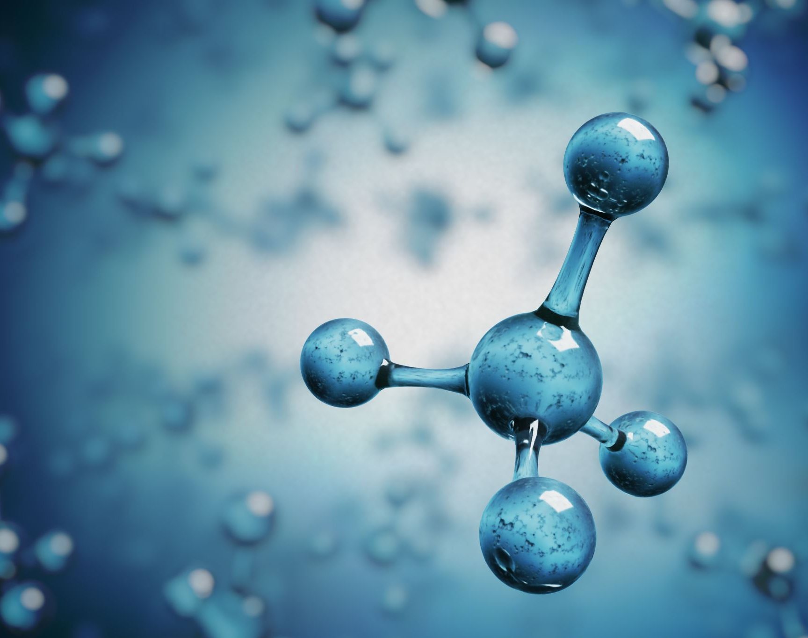
Biomolecular databases and nucleotide sequence alignments
Hardip Patel, PhD
Bioinformatics Lead, National Centre for Indigenous Genomics
Australian National University
BIOL8002 – 2021
Notes:
My name is Hardip and I am Bioinformatics Lead for the National Centre for Indigenous Genomics.

Slide 2
Introductions
Bachelor of Pharmacy, India
Masters of Applied Science, RMIT, Melbourne
Honors Equivalent in Stem cell biology, Monash University, Melbourne
PhD in Biomedical Science and Biochemistry, ANU, Canberra
My work focuses on the identification of human genomic variations between populations and understanding their influence on functional regulation of the genome in health and disease. Our group analyses large scale genome sequence data from Indigenous Australians to ensure appropriate inclusion of diversity in research. We develop analytical workflows and software to process genomic datasets.
Something about you.
Notes:
What is your educational background so far? What types of subjects have you pursued and what is your major? What are your near-term plans after your graduations? Tell me about your experience at the ANU so far? What are your learning objectives from this course and what do you think would help you the most for your future plans?

Slide 3
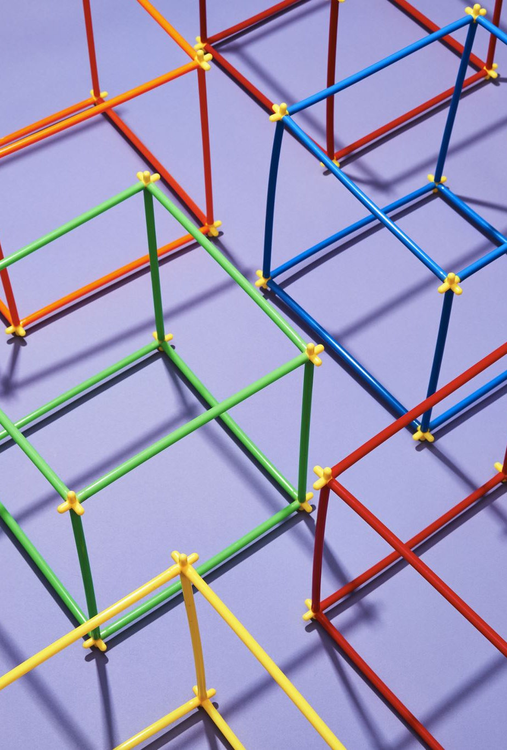
Learning outcomes
Nucleotide sequencing
Annotations, Biomolecular databases and information sharing
Sequence alignments
File formats (if time permits)
Notes:
I will be first talking about the nucleotide sequencing and various technologies available to use for obtaining nucleotide sequence from a given sample.
Nucleotide sequencing is ubiquitous, and it is applied in wide array of domains. Nucleotide sequences are just strings of four characters, A, C, G and T. However, our understanding of their organisation of can provide us with a powerful lens to understand of how life works on earth.
We will discuss basics of nucleotide sequencing in this lecture and more details will be provided to you in the next lecture by Dr. Yu Lin.
Nucleotide sequences, once collected are systematically managed, shared, curated, and stored to create new knowledge and new information. This process is called annotations and is facilitated by large and small data repositories. It is important that we have a comprehensive understanding of these database which manage nucleotide sequence information. Transparent representation and sharing of information across the world allows us to rapidly learn about the current pandemic and contribute towards lessening the impact of this pandemic.
These databases, which store sequence information can be queried using text-based searches. However, their real strength is in allowing us to query sequences using string matching algorithms, also called as sequence alignments in biology. Sequence alignments is one of the most fundamental topic in bioinformatics. Towards the end we will briefly have a look at how sequence alignments is performed in modern biological research to annotate sequences with molecular and evolutionary properties and then subsequently organized in databases.
This session will give you a glimpse of both technical and philosophical theories for organizing, analyzing and interpreting nucleotide sequence data to understand evolutionary and molecular biology and its applications in the real world.
I will be using the COVID19 genome as an example in the beginning, but the concepts and theories are applicable to all organisms with DNA and/or RNA.

Slide 4
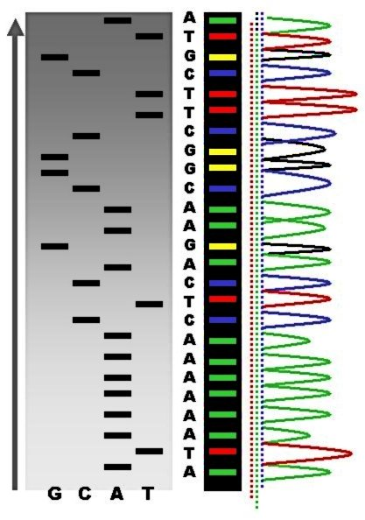
DNA sequencing technologies
First generation
Maxam-Gilbert sequencing
Sanger sequencing
500-1000bp fragments
>99% accuracy
https://en.wikipedia.org/wiki/DNA_sequencing
Notes:
DNA sequencing was first introduced in 1977. Two methods were invented back then. However, due to ease of use and lower use of toxic radioactive materials meant that the Sanger sequencing technology was adopted broadly and the other method sort of died out. Please refer to the Wikipedia page and references thereof for Maxam-Gilbert sequencing.
The innovation in Sanger sequencing was the use of chain terminating nucleotides during PCR reaction. For each DNA molecule that you wanted to sequence, you would set up four separate reactions. In each individual reaction, you would have your normal dNTPs mixed with one of the four chain terminating nucleotide. Once these four separate PCR reactions are complete, you would run the product on a gel. Then, from one of the ends of the gel, you can start compiling a nucleotide sequence for the DNA molecule. For example, in the image here, if we move from the bottom, we will have A, then T, then a series of As, followed by C, T, A an so on. This becomes your nucleotide sequence.
Later on, these gels were replaced by capillaries for PCR product separation. Radioactive material was replaced by fluorophores which allowed for a single reaction instead of four reactions. And finally, compiling of DNA sequence was performed by computers in an automated manner.
One could resolve 500-1000 bp sequence using this technique with great accuracy. This technique is still considered as the gold standard technique. This technique in an automated manner was used for sequencing many genomes including the human, mice and fly genomes.

Slide 5
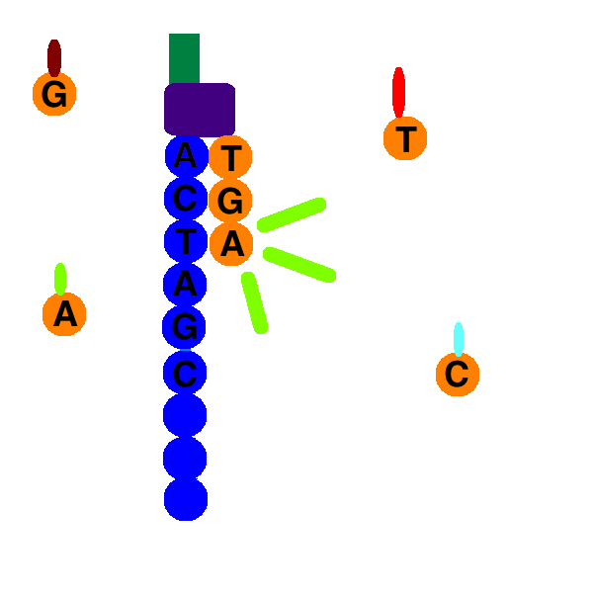
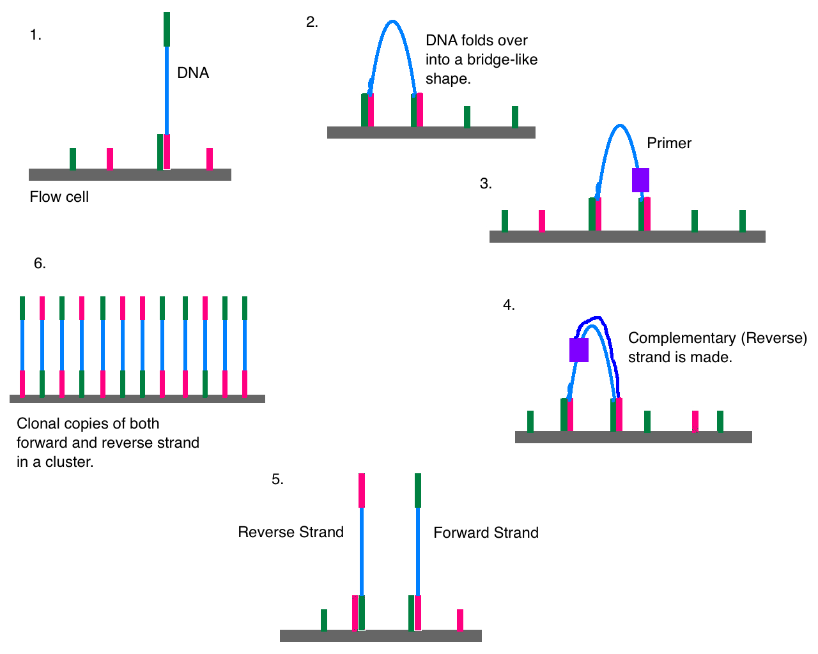
DNA sequencing technologies
Second generation
454
Ion Torrent
Solexa
SOLiD
Illumina
BGI’s DNBSEQ
50-500bp fragments
>99% accuracy
CC BY-SA 4.0, DMLapato
Notes:
In the first decade of the 21st century, a giant leap was made whereby high-throughput sequencing was invented. The idea was to replace capillaries with a solid substrate and read the bases as they are added rather than at the end. This is also referred to as sequencing by synthesis.
Illumina’s method is currently the most popular method and widely used method. One of the innovations in Illumina sequencing was the use of bridge amplification of the DNA molecule. In this, on a glass slide, a DNA molecule is first bound. Once bound, in the local area that molecule is amplified over and over and over. This allows of increase in the signal intensity of fluorophore in the local area.
Once you have thousands of identical copies of DNA molecules in one spot, you start the sequencing reaction by adding fluorescent labelled nucleotides. Once the nucleotide is incorporated in the elongating chain, the elongation reaction stops. Then you wash your slide and take the image. Depending on the colour of the fluorophore, you can determine the sequence of the bases as they are added. In this case, T, G and A.
This technique has high accuracy similar to the Sanger sequencing but read lengths are up to 500bp only. For most applications, this is fine.
This technique allowed for projects such as 1000 Genome Project, Genomics England project, Encode project etc for obtained detailed view of genomic variation and their molecular functions.

Slide 6
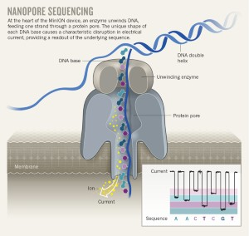
DNA sequencing technologies
Third generation
PacBio and Oxford Nanopore technology (ONT)
~20000 – 50000bp fragments (can reach up to 1.6 million bp)
Single molecule sequencing, no amplification
85-99% accuracy
PacBio Sequencing, https://doi.org/10.1016/j.gpb.2015.08.002
Eisenstein, M. An ace in the hole for DNA sequencing.
Nature 550, 285–288 (2017).
https://doi.org/10.1038/550285a
Notes:
More recently, a third generation of sequencers came about. PacBio and the Oxford Nanopore Technology are leading this field. In PacBio, it is sequencing by synthesis, whereby a DNA molecule is fixed to a tiny well. As the new bases with fluorescent tags are added, they emit colours which are recorded in a movie. Then the movie signal is deconvulated to decipher the DNA sequence. Because reaction doesn’t have to be stopped, and DNA molecule is fixed in a place, it allowed for sequence reads up to 50Kilobases. However, accuracy of these reads is about 85%. Meaning, 15 bases out of every 100 will be still be incorrectly read. However, modifications are occurring to this platform and one can now obtain 99% accurate sequence with PacBio platform.
Oxford Nanopore technology reads DNA natively without synthesis process. Here, the DNA molecule is passed through a tiny pore. As the molecule passes through a pore, based on the nucleotides that passed through, there is a difference in electric current potential across the membrane that is recorded. These electric signals are then decovulated to decipher the sequence.
With this technique, the limit is the size of the DNA molecule that you feed in. People have reported obtaining 1 million base pairs of sequence with this technique. Error rates are high with this technique too but rapidly evolving to improve the quality of the sequencing.
This technique is facilitating the next wave of genome sequencing whereby projects such as Earth Biogenome Project where all living things will have their genome sequenced.

Slide 7
DNA sequencing applications
“If you can make DNA the output of your experiment, then you will be able to scale the experiment beyond your wildest dreams”
Ewan Birney, Deputy Director General of EMBL, Director of EMBL-EBI and Senior Scientist https://www-nature-com.virtual.anu.edu.au/collections/zpsrgkcbkx
Health and medicine
Forensics
Environmental monitoring
Evolution
Molecular biology
Data storage
Notes:
So when it comes to the DNA sequencing, the idea is that techniques will evolve and get better over time. They will provide unprecedented view of the living world at a molecular level.
Ewan Birney, who is the director of EMBL-EBI in Europe, once noted to that effect that if you can design your experiment in such a way that final output is a DNA molecule, then you can scale your experiments beyond your imagination.
DNA sequencing is used in applications as wide as health and medicine, environment monitoring, evolutionary studies, molecular biology and even for storing data.
Let’s see how DNA sequencing is employed in the management and understanding of the current COVID-19 pandemic.

Slide 8
COVID-19 pandemic
WHO timeline for the COVID-19
https://www.who.int/news-room/detail/29-06-2020-covidtimeline
First known to WHO on 31st December 2019
11th January 2020, the first genetic sequence obtained
Sequence released for public use on 22nd January 2020
Genomic characterisation and epidemiology of 2019 novel coronavirus: implications for virus origins and receptor binding
Lu et al, The Lancet, Volume 395, Issue 10224, 22–28 February 2020, Pages 565-574, https://doi.org/10.1016/S0140-6736(20)30251-8
29,829bp genome of the virus
88% similarity with bat-derived severe acute respiratory syndrome (SARS)-like coronaviruses
“might be able to bind to the angiotensin-converting enzyme 2 receptor in humans”
Notes:
As we know that COVID began late last year. The threat of the pandemic was first noticed by WHO on 31st December 2019. Within 11 days, we had the whole genome sequence of the virus that was causing the disease. The research paper for the same was published by the end of February.
In published work, the main findings were that the genome is 29Kb long with 88% similarity to one of the bat derived sars like coronavirus.
Researchers were also able to interpret information from the sequence data to suggest that Angiotensin-converting enzyme 2 receptor may be the binding partner in the human cells for the viral entry.
This is amazing pace of discovery and information sharing. This is made possible by the availability of variety of biomolecular databases.

Slide 9
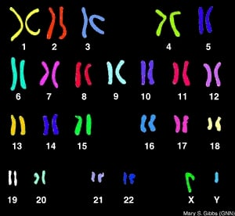
Genome information content
20,442 protein coding genes
23,982 non-coding genes
42,543 microsatellite
1,884,172 SINE repeats
1,594,040 LINE repeats
~40% GC bases & ~60% AT bases
4130 genes with phenotype causing mutations
Orthologous genes (shared common ancestor)
1271 genes with one2one orthologs in Yeast
16769 genes with one2one orthologs in chimpanzee
https://asia.ensembl.org/info/website/glossary.html for glossary
John_Mitchell_WV, https://www.proprofs.com/
Notes:
Similar to the corona virus, we know a lot of information about the human genome too.
Human DNA codes for nearly 20000 protein coding genes and about 39000 noncoding genes that include miRNAs, piRNA, small nucleolar RNAs, tRNAs, rRNA, pseudogenes and so on. Apart from these genes, genome also contains repeat elements. There are nearly 43000 microsatellite repeats, 1.9 million short interspersed nuclear element or in short SINE repeats and 1.6 million LINE repeats. DNA is made up of four sugar bases. A, C, G, & T. These are not uniformly distributed and that there is ~40% GC content in the DNA as opposed to 60% AT content. Then we also know by one estimate that there are 4130 genes with specific mutations that cause a phenotype. Yeast and humans have around 1300 genes that are orthologous, meaning they were present in the common ancestor of yeast and humans and yeast and humans have inherited those genes since the split with yeast. Similarly, as we look at more closely related species such as chimpanzee, we share 17000 orthologous genes. Overall, as you can see, we know a lot of the human genome. Collectively, this information helps us understand the function of the genome at a molecular level. This is just the tip of the iceberg.
We have similar level of understanding for 10s of thousands of species. Biology is complex and we have done well so far in managing this complex information. There are tons of useful databases that provide in-depth knowledge of the structure and function of the genome and for the next hour or so I will show you what these databases are, how is the information structured in these databases and how to access it, how we have identified these functional properties of the human genome and the sequence of the genome so far.
2593 genes with one2one orthologs in C elegans
12058 genes with one2one orthologs in chicken

Slide 10
Human genome sequencing
Shotgun sequencing
Announced in 1990s by NIH and DOE
Many countries and companies joined in that decade in the quest of producing the human genome
Celera produced 27.27 million DNA reads
IHGSC produced sequence data from 29298 overlapping BAC clones (about 7x coverage)
Two important principles
Collaboration open to any center in any nation
Genomic sequence data be made publicly available within 24 hours of assembly
200 centers, large volume of data
International Human Genome Sequencing Consortium. Initial sequencing and analysis of the human genome. Nature 409, 863 (2001). All rights reserved
Notes:
To understand these databases and their content, we need to begin at the very beginning.
The plan to map sequence of the human DNA was created and approved in late 80s early 1990s. National Institutes of Health and Department of Energy joined forces together as primary funders followed by large scale efforts from other countries. While major players were busy at large scale sequencing of full genomes, there were many small labs performing sequencing too. And just so you know, before the human genome was published in 2001, there were many other organisms with their full genomes determined and published. First was that of Haelmophilus influenzae virus.
There were two distinct approaches taken by two leading organisations to determine the sequence of the human genome.
Overall, Celera, a private company, produced some 27 million reads and the international consortium produced sequence data from nearly 30000 BAC clones. International consortium adopted two important principles in generating data. The first principle was to keep collaboration open for any center from any nation and they preferred it that way although it was not economical. This was because they shared the sentiment that the human genome sequence is a shared heritage for all of the humanity and therefore the work had to go beyond national boundaries.
Second important principle they adopted was that data must be available within 24 hours to the public without any restriction. This was to foster scientific enquiry as quickly as possible and by as many interested researchers as possible.
We can thank these early visionary principles for the progress that we are currently making in genetics research and fighting current COVID19 pandemic. Without these principles, we would not be where we are.
The reason why it is important to understand this is that nearly 200 centers worked together to produce data at a factory scale. This has to be a highly coordinated effort and to ensure that all data is available a database was required.
Genomes sequenced before the human genome.
1995: Haemophilus influenzae
1996: Saccharomyces cerevisiae and mouse cDNAs
1997: Escherichia coli
1998: Caenorhabditis elegans
2000: Arabidopsis thaliana
2001: The human genome
Reading list:
Chial, H. (2008) DNA sequencing technologies key to the Human Genome Project. Nature Education 1(1):219, http://tinyurl.com/y4hu8fa5
https://www.genome.gov/human-genome-project/What
International Human Genome Sequencing Consortium, Initial sequencing and analysis of the human genome, Nature, volume 409, pages860–921 (2001), https://www-nature-com/articles/35057062
https://science.sciencemag.org/content/291/5507/1195
Venter et al, The sequence of the human genome, Science 16 Feb 2001: Vol. 291, Issue 5507, pp. 1304-1351, DOI: 10.1126/science.1058040
The approach taken by the international human genome sequencing consortium was to break the DNA into smaller fragments of about 200Kilobases in length and cloning them into Bacterial vector system called BAC clones. Then overlapping clones were identified using physical mapping of the clones onto chromosomes using FISH, sequenced tagged sites, and DNA fingerprinting. Once overlapping clones were identified, then these clones were individually broken into further smaller fragments and sequenced using Sanger sequencing method. Sequences from the smaller fragments were put together by overlap layout consensus method of assembly.
As you can see how this method allows us to decode the genome accurately. Later on, a private company called Celera led by Craig Venter joined the race and planned to sequence the entire human genome in three years. They thought of a clever way to sequence the genome rapidly. They avoided the BAC cloning and identifying overlapping clone steps. These were very time consuming and lot of manual labour was involved. Instead, they chose the path of breaking down the genome into fragments of about 1000bp and sequenced them directly. Once sequenced, they used sophisticated algorithms to put together the human genome. This Celera method is now the de facto standard for whole genome sequencing.
Both teams, International consortium and the Celera team finished the first draft of the human genome sequence with 96% coverage early in 2001.

Slide 11
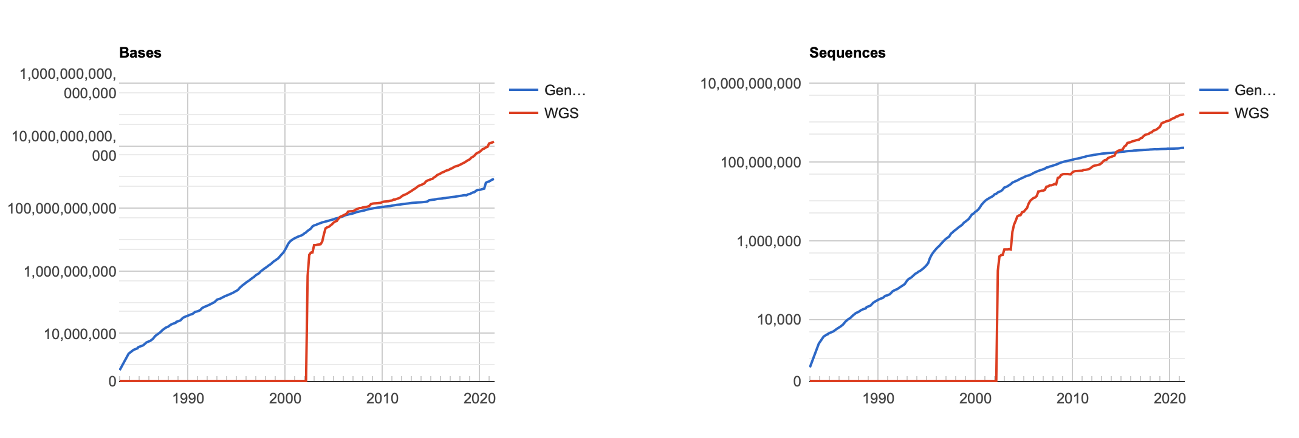
GenBank® https://www.ncbi.nlm.nih.gov/genbank/
Established in 1982
International Nucleotide Sequence Database Collaboration (INSDC)
DNA DataBank of Japan (DDBJ)
European Nucleotide Archive (ENA)
GenBank at NCBI
All data without any restrictions on use
New release every two months
8.6x10¹¹ bases in 2.3x10⁸ sequences
“an annotated collection”
Sequence Read Archive (SRA) and Trace Archive
55.36x10¹⁵ bases
Not mirrored
NOTES:
Scientific publications require data to be deposited in public repository
China National GeneBank is not a signatory of the INSDC
Other wealthy nations such as Australia, New Zealand, and Canada are also not signatory
Sovereign risk to the data
Notes:
To organize all the nucleotide sequence data not only for humans but for any organism, GenBank database was used. GenBank was established In 1982 with the aim of being able to store and share nucleotide sequence data so that researchers can use them to ask variety of questions in evolutionary and molecular biology. GenBank is part of the international nucleotide sequence database collaboration including two other members: DNA databank of japan and European Nucleotide Archive. These three organisations exchange information on daily basis and some of the information is mirrored at all three sites. This mirroring of the information is very important to ensure a level of redundancy is maintained if for any reason, one of the database is unbale to serve the community. The primary goal of this collaboration is to ensure that sequence data deposited into their collections is freely and permanently available. So once the information is entered in here, it cannot and will not be deleted.
Genbank releases a new version of the database every two months. Currently it holds 8.1 trillion bases in 1.3 billion sequences. GenBank is primarily annotated collection of sequence data. This means that DNA sequence data that is not annotated for its properties, then it is not part of the Genbank. For such sequences, sequence read archive and trace archive databases were created. Specifically to note here is that these sequence read archive databases are not mirrored across three sites as the volume of data is too large. Currently, SRA alone holds 43 petabases of sequence data. This explosion of data is attributed to the high-throughput sequencing that we discussed earlier. The rate of data collection is more than doubling every year.
So how does one make sense of all these data. How can we know a sequence is from what species, who submitted it, when it was first discovered and so on and so on?
https://www.ncbi.nlm.nih.gov/sra/docs/sragrowth/

Slide 12
Data retrieval
Standardisation of file formats
GenBank
Fasta
FastQ
https://genome.ucsc.edu/FAQ/FAQformat.html
https://genome.ucsc.edu/ENCODE/fileFormats.html
Search tools
Entrez: text search and retrieval system
PubMed database of biomedical literature
38 other literature and molecular databases (GenBank, RefSeq, Genes, Genomes, Proteins, Chemicals etc)
Course for using these systems
Basic Local Alignment and Search Tool (BLAST®)
Nucleotide and amino acid sequence databases
Notes:
To ensure that all data is accessible is one part of the story, but meaningful retrieval and understanding of the data is another. For that, standards have been developed for storage and retrieval of data and these standards have evolved with new types of data available. As bioinformatics students, you must spend some time in understanding various file formats and annotation language so that you can effectively understand the contents of these databases and manipulate or process the information for your scientific enquiry. If you click on the links for three formats listed here, you can understand the format and understand what information is contained in a GenBank record or a Fasta record or FastQ record. You can also read about other formats in the other two links provided based on your requirements.
We will have a look at this file formats and see what information is contained in such records now.
Once the records are standardized, one can use specific language, which is referred to as controlled vocabulary, to search and retrieve information. NCBI offers one of the most sophisticated text-based search and retrieval system called Entrez. It is a portal that exposes you to entirety of PubMed and 38 other molecular and literature databases. These are very large and very sophisticated databases and you may benefit from looking at the course link depending on your needs. For now, my job is to expose you to all of these information and make you aware of the publicly available contents so that based on your domain expertise in the future, you can learn in a targeted approach.
Apart from text-based search, you may be interested in retrieving sequence information based on the DNA or amino acid sequences that you have. For that, one of the fundamental tools used is called BLAST. In the later half of this seminar we will go over details of sequence similarity and how does BLAST work. For now, it is sufficient to know that you have all the avenues of finding information stored in databases. Most of these information is structured and publicly available for free to download, process, distribute in anyway you can imagine.

Slide 13
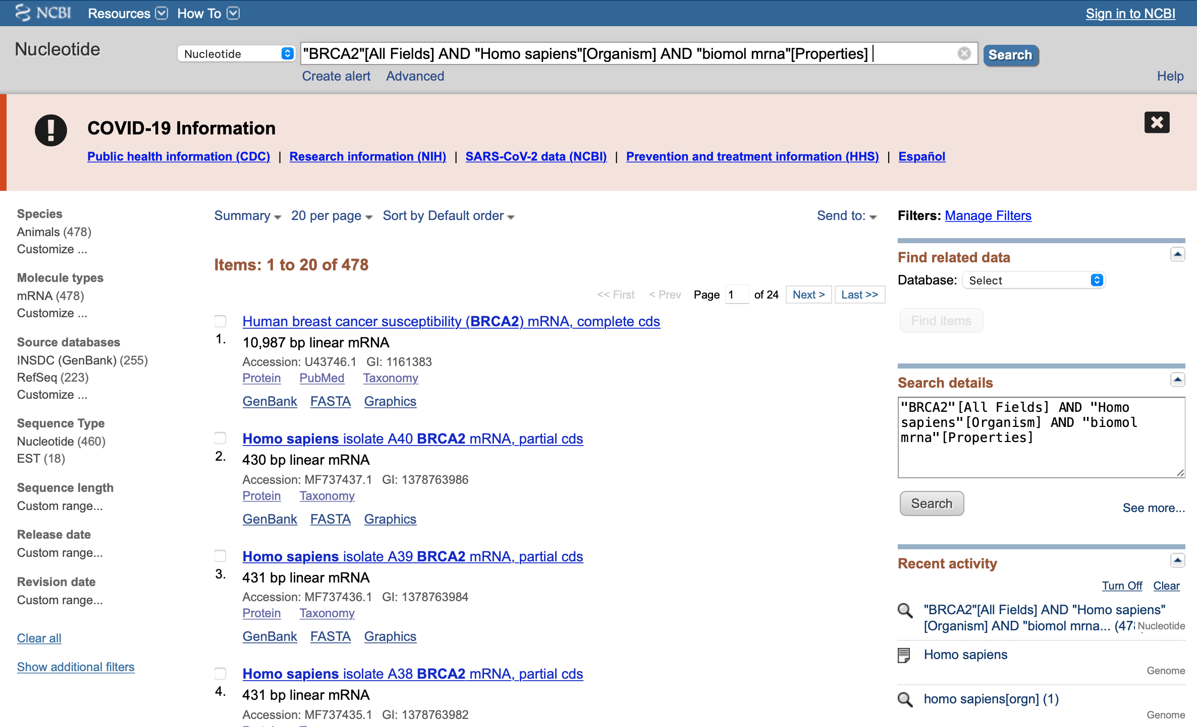
Redundancy in GenBank®
BRCA2 mRNA example
https://www.ncbi.nlm.nih.gov/nuccore
"BRCA2"[All Fields] AND "Homo sapiens"[Organism] AND "biomol mrna"[Properties]
Multiple records are present in GenBank
Data owned by original submitter and cannot be modified
Notes:
As you may have wondered, that yes the information is available but how do you understand such vast amount of information and how to make sense of it all to understand basic biology. For example, you may have obtained nucleotide sequence of mRNA from a gene called BRCA2 from your model cell line. At the time of publication, you deposit your version of the sequence in the GenBank database as per the requirement. Your collaborator does the same and obtains the sequence data for the same gene from another cell line. As per requirements, they would have to submit their sequence to GenBank too. Now you have overlapping records of the same gene from the same species. Sometimes the issue is that information is partial and not complete for a gene. For example, I searched for BRCA2 in humans as mRNA sequence and we get around 433 results. Not all of them are from BRCA2 gene and when the records are from the gene, often they are partial records. So which one do you trust, and which one do you use in your research.
When you want to retrieve the sequence, you have to sort through similar GenBank entries to figure out which is correct, which one should you trust more, and which one should you cite for your subsequent publications.

Slide 14
RefSeq: derived database
RefSeq database, USA
“comprehensive, integrated, non-redundant, well-annotated set of sequences”
Represent genomic DNA, transcripts, and proteins
Curated by NCBI staff and collaborators
Reflect current knowledge of sequence data and biology
Records owned by NCBI
NCBI video library: https://www.youtube.com/user/NLMNIH
Notes:
To ensure that users can process and understand non-redundant information in a way that can progress biological research, there are derived databases that have been created so that us as users of information have unified set of non-redundant records that you can rely on.
One of such database is called RefSeq. It is a collection of comprehensive, integrated, non-redundant, well-annotated set of sequences. These sequences can represent genomic DNA, transcripts and proteins. These sequences are derived and calculated from underlying records in GenBank or Sequence Read archive; the INSDC datasets. As we saw earlier, GenBank and other INSDC data collections are used as primary repository for archiving all data, they are not actively curated, and it is the responsibility of the data submitter for accuracy of the submission. Primary data can even have mistakes and there is no curation applied to such primary data.
RefSeq on the other hand provides access to curated and updated information with the current knowledge and ensures that data is appropriately validated. This process of curation is partially automatic but human decision makers are involved in the curation process to ensure accuracy of the information. And since these curation is performed by NCBI and its collaborators, the RefSeq data is owned by NCBI. The intellectual property rights reside with NCBI.

Slide 15
Ensembl: derived database
http://www.ensembl.org, EMBL-EBI, Europe
Video tutorials can be found at https://ensembl.org/info/website/tutorials/index.html
Automatically annotate the genome
Integrate with other available biological data
Publicly available via the web
Comparative genomics is strength
Annotations can be different between RefSeq and Ensembl
Direct access to mysql databases
Extensive Perl and BioMart API for interacting with underlying mysql database
Notes:
Similar to RefSeq of NCBI in the US of A, there is another widely used derived database called Ensembl. Ensembl team is based at the European Molecular Biology Laboratory’s European Bioinformatics Institute located in Cambridge in the United kingdom. When the data was being generated for the human genome and other species, it was evident that manual curation of sequence data would be impossible and would take too long for its use by researchers in a timely manner. To overcome this issue, they relied on developing automated pipelines for annotation of the genome. Since its beginnings in 2000, they now provide comprehensive annotations of genomes for Eukaryotes, metazoans, plants and prokaryotes. There are nealy 40-50 fulltime staff working on the Ensembl project at any given time to provide us with up to date knowledge of genomes and their annotations via the web. This group specializes in comparative genomics and that is their biggest strength I believe. Comparative genomics is a branch of bioinformatics where comparisons are made between species to understand evolutionary processes that have shaped genes and genomes of different species. For the annotations and comparative analysis, they use their own in-house developed or collaborative frameworks and pipelines. What this means is that their pipelines and tools can be different with different strengths and weaknesses that can results in annotations being different between RefSeq and Ensembl. They wont be drastically different on a global scale but on a local scale they can be different. They provide direct access to their underlying mysql database so that you can query databases using mysql queries to perform complex operations with their data. They also provide Perl based application programming interface to interact with the data. Also, structured data are available for download from APIs using bioMart.

Slide 16
UCSC Genome Browser: derived database
https://genome.ucsc.edu/, University of California Santa Cruz
Similar to Ensembl in many respect
Three part blog post for accessing data programmatically
Part 1, Part 2, and Part 3
Easy to use for user supplied data using tracks
Shows many experiments that can be switched on and off easily as tracks
Offers mysql database access
Very fast high similarity sequence search using BLAT tool
Selective export of data as per the user requirement using Table Browser
Notes:
Another major player in this game is the UCSC Genome Browser. This browser is very popular for browsing genomic information too. It is in many ways similar to the Ensembl Genome Browser so I wont go into too many details of it. They all began with the aim of displaying genomic data and their annotations via web. There is a very nice and simple tutorial available for accessing UCSC genome browser data programmatically and links are provided in the slide. Compared to the Ensembl browser, this browser is easy to use for user supplied data. So you can have your unpolished data displayed next to the publicly available data. You can also create permanent tracks for sharing with your collaborators. Because of its ease of use, you can configure the browser to your hearts content for looking at results of big projects such as Encode project. This too offers mysql based interface to the data. It was UCSC team back in the day who developed a BLAT tool which is short for Blast like alignment tool. This tool is very fast for highly similar sequences and one can use it to search for specific sequences. You can also use their table browser functionality to export selective datasets and tracks.

Slide 17
UniProt: derived database
The Universal Protein Resource, https://www.uniprot.org
Comprehensive resource for protein sequence and annotations
UniProtKB/Swiss-Prot (reviewed)
manually annotated
experimental results, computed features and scientific conclusions
UniProtKB/TrEMBL (unreviewed)
Programmatically generated protein sequences
UniProt videos: https://www.youtube.com/user/uniprotvideos
Notes:
While other databases focused on genomic information, there was need to have a database that was dedicated for protein information and hence UniProt was created in early 2000. This is an exhaustive and up to date database for protein sequence informatics. There are two main streams in UniProt database. The first is Swiss-Prot which is manually curated and reviewed by humans. This ensures high quality of annotations of experimental results and computed features with scientific conclusions all in one place for a protein sequence of interest. As opposed to Swiss-Prot, the TrEMBL data section contains predicted protein sequences from cDNA sequences that are deposited in the NCBI GenBank database.

Slide 18
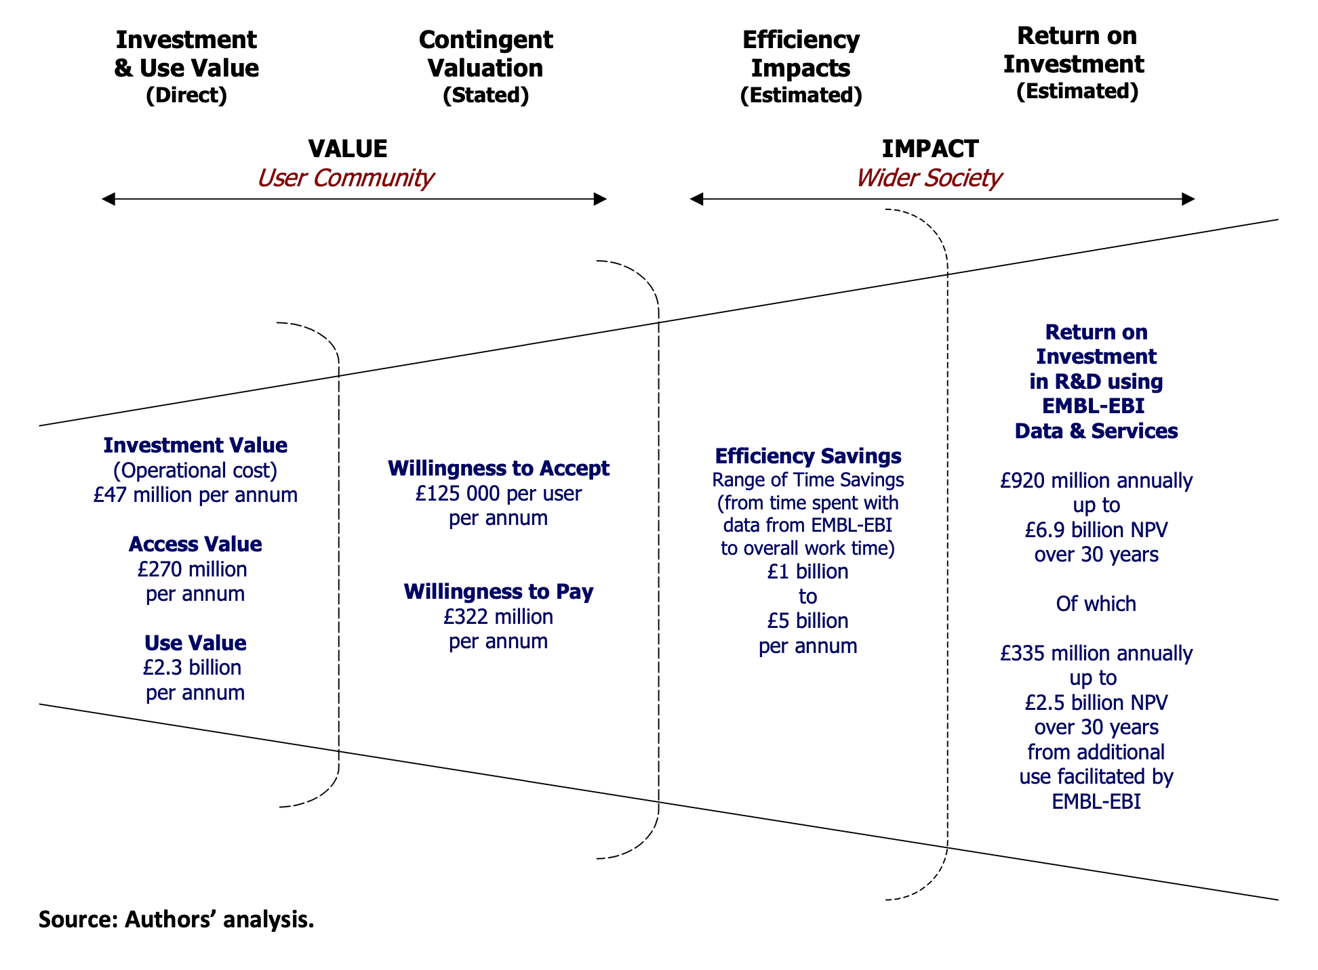
Summary
Biomolecular data is organized systematically
International collaborations and consortiums are vital
Programmatic and web access to all data
All data is freely available
￡47 million/year EBI cost
￡920 million/year ROI
Figure captured from https://beagrie.com/static/resource/EBI-impact-report.pdf
Notes:
So with that, hopefully you have learned about various databases and their existence. It is important to note that biomolecular data is organized systematically and is freely available from variety of sources. Before you begin your experiments to generate new data, it is worthwhile to check these databases to see if someone has generated data for your experiment. There is enough data to keep us all busy for a foreseeable future. These resources are created by international community of collaborators, government and private agencies. All databases make an effort to provide their data either through point and click web-based access and programmatic access for large volumes. According to one estimate, just for the European Bioinformatics Institute with a total operational cost of 47 million pounds per year, it provides 920 million pounds worth of return in terms of research value it creates. That is a very good return on investment. All government agencies should look into funding this high-quality data driven world so that more discoveries can be made.

Slide 19
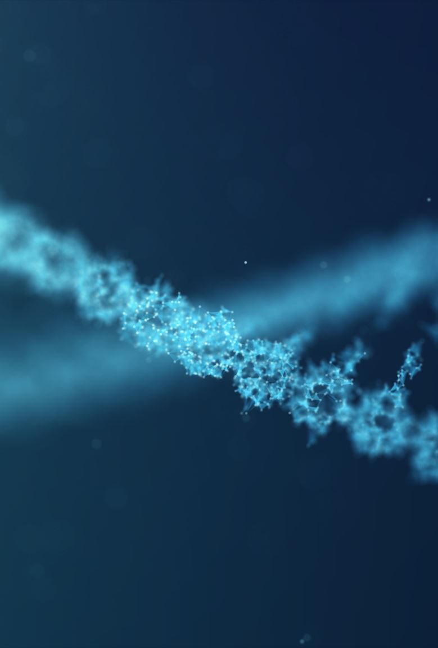
Practice
Entrez NCBI
RefSeq
Ensembl genome browser
UCSC genome browser
UniProt protein database

Slide 20
Sequence similarity
Measure of relationship between sequences
Used to determine shared ancestry
Used to annotate unknown sequences
Notes:
In this part, we will have a look at the fundamental topic in bioinformatics. Sequence similarity searching and alignments. We looked at various databases and it is perhaps evident that there is vast amount of annotations available. How do we annotate a sequence to know if it derived from Corona virus or a human sample. If it a gene or a microRNA or a repeat element within it? How do we know if the sequence is conserved between species and what is its evolutionary properties?
All of these has been powered by pairwise sequence similarity searches and alignments. We will in next few slides learn about various types of alignments and look at pairwise alignments in a little detail.
Sequence similarity is a measure of relationship between sequences. A common objective of sequence similarity calculations is establishing sequence homology to determine if sequences have evolved from a common ancestor. A similarity score is therefore calculated between pairs of sequences to understand the evolutionary distance between nucleotide or protein sequences. By employing sequence similarity calculations, we can infer functional properties of the DNA and use it to annotate new sequences.
We will learn about software that can help us do search and alignments using a database of sequences. And we will briefly learn about how to interpret results of an alignment.

Slide 21
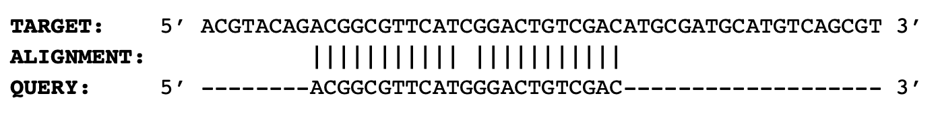
Sequence similarity searches and alignments
Local alignment
Any two sequences, looking for conserved elements
Smith-Waterman algorithm
Notes:
Sequence alignments can be divided into two categories; local alignments and global alignments. Local alignments as the name suggests finds local regions of highest similarity between a pair of sequences. Global alignments on the other hand is used for end-to-end alignments. Because local alignments are used for finding similar subsequences between a pair of sequences, it can be used for any two sequences to find conserved subsequences such as exons or motifs between target and the query sequences without a priori knowledge of similarity between two sequences.
Because global alignments are end-to-end, one can use it when there is a priori knowledge of similarity between two sequences such as orthologous gene between human and mouse.
https://en.wikipedia.org/wiki/Sequence_alignment
https://en.wikipedia.org/wiki/Smith%E2%80%93Waterman_algorithm
https://en.wikipedia.org/wiki/Needleman%E2%80%93Wunsch_algorithm

Slide 22
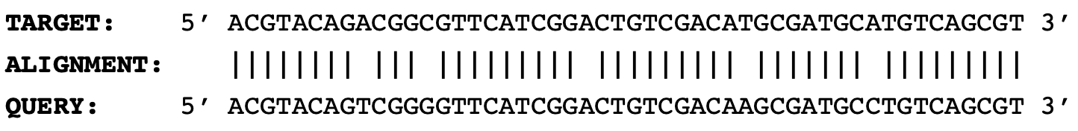
Sequence similarity searches and alignments
Global alignment
Similar sequences, looking for alignment properties
Needleman-Wunsch algorithm
Notes:
Sequence alignments can be divided into two categories; local alignments and global alignments. Local alignments as the name suggests finds local regions of highest similarity between a pair of sequences. Global alignments on the other hand is used for end-to-end alignments. Because local alignments are used for finding similar subsequences between a pair of sequences, it can be used for any two sequences to find conserved subsequences such as exons or motifs between target and the query sequences without a priori knowledge of similarity between two sequences.
Because global alignments are end-to-end, one can use it when there is a priori knowledge of similarity between two sequences such as orthologous gene between human and mouse.
https://en.wikipedia.org/wiki/Sequence_alignment
https://en.wikipedia.org/wiki/Smith%E2%80%93Waterman_algorithm
https://en.wikipedia.org/wiki/Needleman%E2%80%93Wunsch_algorithm

Slide 23
Pairwise alignments Dot-matrix
Locally optimal alignment not guaranteed
ACGTACGT
ACG-----
A C G T A C G T
A 1 0 0 0 1 0 0 0
T 0 0 0 1 0 0 0 1
C 0 1 0 0 0 1 0 0
T 0 0 0 1 0 0 0 1
A 1 0 0 0 1 0 0 0
C 0 1 0 0 0 1 0 0
G 0 0 1 0 0 0 1 0
A 1 0 0 0 1 0 0 0
ACGTACGT
---TACG-
Notes:
Pairwise local alignments methods can be divided largely into three categories. Dot-matrix, dynamic programming and k-mer based heuristic methods. In dot-matrix method to identify regions of high similarity, a matrix is created. One of the sequences is arranged in the top row and the other sequence is arranged in the first column. Now for each matrix cell, you ask the question if the nucleotide or the amino-acids are identical or not. You score it as 1 if the nucleotide of the column matches with the nucleotide of the row and if it doesn’t match, then you write it as 0. Once the matrix is filled, one can look for diagonally contiguous 1s to identify locally matching sequences. In the example, I have shown here, there are two regions of similarity between the target and the query sequence. This is the most basic form of pairwise alignment. In dot-matrix methods, all matches and mismatches are treated equally, and we can cannot know which alignment is optimal. In this example, there is a 3nt long alignment and a 4 nucleotide long alignments of the query sequence to the target sequence. Both are valid but not locally optimal as they overlap on the query sequence.

Slide 24
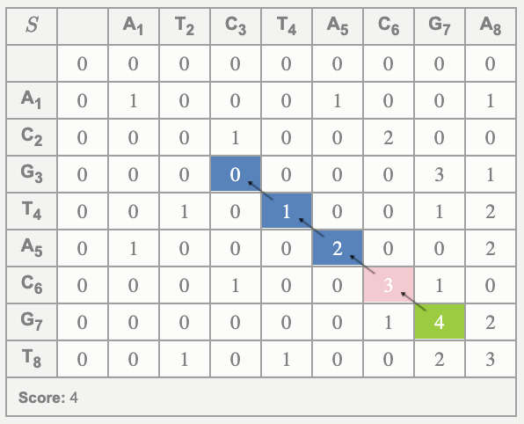
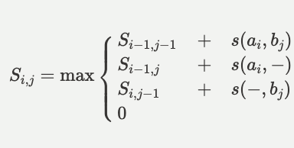
Dynamic programming (Smith-Waterman algorithm)
Locally optimal alignment guaranteed
Match = +1
Mismatch = -1
Gap = -2
For i=1 and j=1,
S_{i-1,j-1} + s(a_{i,}b_{j}) = 1
S_{i-1,j} + s(a_{i},-) = -2
S_{i,j-1} + s(-,b_{j}) = -2
0
Maximum value = 1
ACGTACGT
---TACG-
Notes:
Dynamic programming is way of identifying locally optimal alignments with the highest score. Smith-Waterman algorithm is a version of dynamic programming that is routinely used for pairwise local alignments. Why is this algorithm called dynamic programming? Because it tries to solve the problem of identifying local similarity based on similarity of bases in the local neighborhood. This also starts with a matrix similar to the dot-matrix. The difference is that the first row and the first column are filled with 0 as the values.
The values in each cell is determined by the equation on the right. And for this example, we use the match score of 1, mismatch score of -1, ie. penalty of 1. And similarly, gap incurs a score of -2.
So we start with the top-leftmost empty cell. For the value of the cell, you want to get the maximum value in the cell following the equation on the right. In its simplest form the equation determines the maximum value in the current cell based on the values in the left diagonal cell, the cell above and the cell on the left.
In this example, for the first comparison, the value of the cell diagonally above is 0, so for the first part highlighted in black, we take 0 + 1 because the nucleotides are matching, which gives us 1. We subtract 2 for the brown part of the equation giving us a value of -2. For the blue part we do the same and subtract 2 giving us the value of -2. Out of four values, 1 is the maximum value so we put 1 as the value of the first cell. Similarly, we can keep going and fill up the entire matrix. Once we have filled in the entire matrix, we identify the cell with the maximum value, 4 in this case and trace back up to zero. At the maximum value, we ask the question, which of the nearest neighbor above, on the left or diagonally on the left has the maximum value. We trace back up to zero and identify the alignment.
http://rna.informatik.uni-freiburg.de/Teaching/index.jsp?toolName=Smith-Waterman#

Slide 25
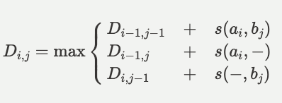
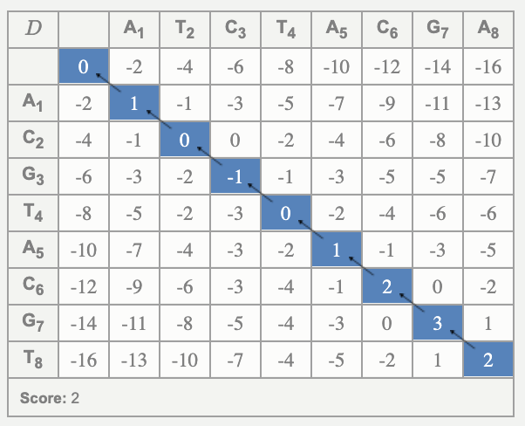
Pairwise global alignment (Needleman-Wunsch Algorithm)
Can have negative values in the cell
Tracing starts at the bottom right corner
ACGTACGT *||****| ATCTACGA
Martin Mann, Mostafa M Mohamed, Syed M Ali, and Rolf Backofen Interactive implementations of thermodynamics-based RNA structure and RNA-RNA interaction prediction approaches for example-driven teaching PLOS Computational Biology, 14 (8), e1006341, 2018.
Notes:
Pairwise global alignments are similar to the Smith-Waterman algorithm. In fact, Needleman-Wunsch algorithm was first described for similarity and Smith-Waterman algorithm is a variation of the same. The difference between the two is that in global alignments using Needleman-Wunsch algorithm we omit the 0 so that cells can have negative values. The second difference is that unlike smith waterman where tracing starts at the cell with maximum values, tracing begins in this at the bottom right corner.

Slide 26
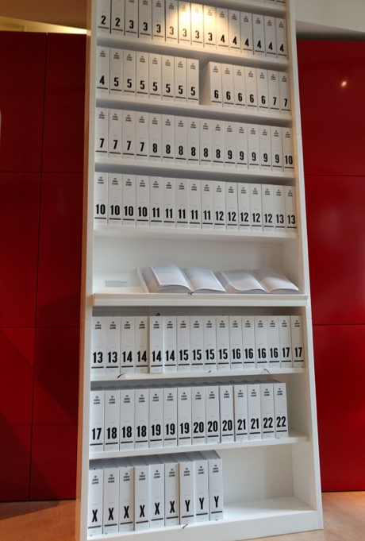
Heuristic methods
Search entire human genome
Searching GenBank® with thousands of genomes
Basic Local Alignment Search Tool (BLAST®)
Index the book
Start position of each word is known
Look for exact matches to these index words
If the distance between a pair of words in query and target is similar, then perform SW alignment
Figure 1 Printed copy of the human genome in 130 volumes, each volume with 1000 pages (image from https://imgur.com/gallery/Xacx3QJ).
Notes:
So as we have noticed that for a pairwise local alignment, the idea is to identify locally optimal highest similarity regions. But the problem is quite large. Think about this, if the human genome is printed on a regular A4 sized paper, it spans 130 volumes. And Wellcome Collection has it on display, the book of the human genome. So quite large. Now the problem is that you have sentence that you want to know if it matches anywhere in these books. We can not go check each page at a time and create matrix to find locally optimal sequence alignment. Heuristics have to be applied to speed up the search and alignment process. How can we speed up the alignment in this case.
For the speed up, we can index all words of a fixed length in the target sequence so that we know every location of a word. Now we can ask the question, do I have matching words between my query sequence and the target sequence using these index words. If matches are found, then we can check if the distance between two words found is similar for the query and the target. If the answer is yes, then matches between and around those words can be extended using Smith-Waterman alignments.
In short, all recent algorithms are variations of these basic principle. Create an index of target sequences to reduce search space.

Slide 27
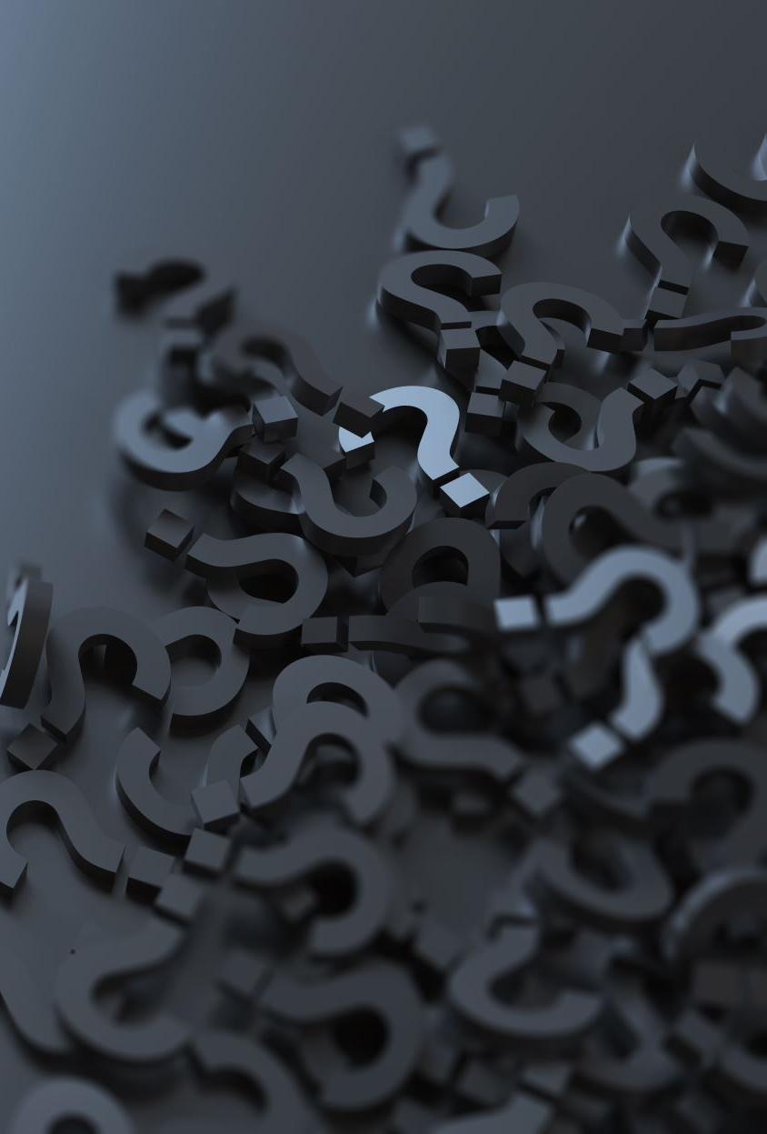
Properties of heuristic methods
Locally optimal alignment NOT guaranteed
May miss remotely similar sequences completely
Very fast
Software for search and alignments:
BLAST®, FASTA, SSEARCH, HMMER for range of similarity level
BLAT, minimap2 for highly similar sequences
BWA, Bowtie, HISAT etc for millions of sequence searches with ++similarity
Notes:
There are several important considerations one must understand when using heuristic based methods. These methods may miss some matches and therefore the locally optimal alignment is not guaranteed. Similarly, if the size of the k-mer chosen is too large, it may completely miss some remotely similar sequences.
However, these tradeoffs allows us to scan all of the NCBI database in matter of seconds and therefore they are very fast. There are many software available for pairwise alignments and I encourage you all to read papers that describe these software and the principles of their algorithms from the internet so that you have a good understanding of these methods. It will be important to choose the correct software based on your applications to obtain reliable results fast.
I would also encourage you to read about various statistics used to assign scores for alignments.

Slide 28

Similarity vs homology
Homologous sequences
Share a common evolutionary ancestor
What similarity level equal homology?
>> similarity than expected by chance
two sequences did not arise independently
Shared a common ancestor
Not all homologous sequences share similarity
Natural selection
Notes:
Sequence similarity searching as discussed in previous slides is used to identify homologous sequences. It is one of the first, and most informative, steps in any analysis of newly determined sequences. COVID19 sequence was determined to be corona virus sequence based on similarity searches. Similarity can tell us if two sequences have any sub sequences that are similar at a defined level. However, it can not allow us to infer if those two sub sequences are homologous.
https://www.ncbi.nlm.nih.gov/BLAST/tutorial/Altschul-1.html

Slide 29
Practice
BLAST search
BLAT search

Slide 30

File formats and sequence representations
For sequences
Fasta files
Fastq files
For alignments
SAM/BAM files
For variations
VCF files
For annotations
Bed, gff3, GTF files for annotations (interval based)
Notes:
Please read about these file formats at your convenience as they will be very useful for you in your future work.

